Slide 1
WELCOME
30th Annual
Convention & Trade Show

Slide 2
#NARPM2018

Slide 3
WHO, WHAT, WHY, WHEN, & HOW
OF PROPERTY INSPECTIONS
Bryan Jenkins, MPM RMP
AHI Properties

Slide 4
WHY
Protect the Security Deposit
Create Accountability
Reduce Risk/Liability (PM & Homeowner)
Discover Unreported Maintenance

Slide 5
WHEN
Initial Acquisition

Slide 6
WHEN
Periodic

Slide 7
WHO
Property Manager
“Hands-on” Approach
Time/Conflict
Maintenance/Contractors
Inexpensive/ No Scheduling
Ineffective/ No Report
Tenant Self-Inspect
No Upfront Cost/ No Time Invested
Court Documentation/ Increased Liability
Full/Part- Time Staff
Control of Process
Staffing/Cost/
Consistency
Third-Party Vendors
Consistency/ Pass-Thru Cost/ Deliverable
Loss of Control

Slide 8
WHERE
Field
Laptop

Slide 9
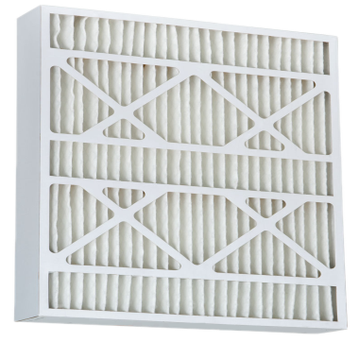
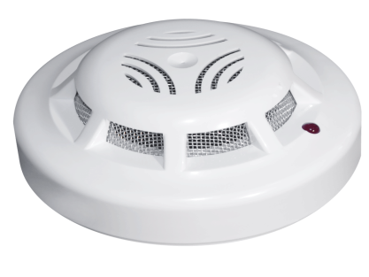
WHAT

Slide 10
HOW
Admin Fee
Coordination Fee
PM Pay
Owner Pay
Co-Pay
Lease Renewal Fee
Tenant Pet Inspection Fee

Slide 11
Questions?
#NARPM2018

